Slide 1

CLASS 11 ENGLISH • HORNBILL
We're Not Afraid to Die... if we can all be together
BY GORDON COOK & ALAN EAST
A gripping real-life chronicle of human endurance, unyielding courage, and family solidarity against the violent storms of the Southern Indian Ocean.

Slide 2

Part I: Setting Sail
Retracing history, building dreams, and planning the ultimate voyage across uncharted global waters.
WE'RE NOT AFRAID TO DIE...
SLIDE 2

Slide 3

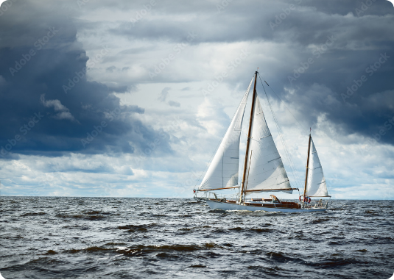
Wavewalker: The Vessel
Constructed over years of relentless preparation to face the harshest ocean currents on earth.
Sleek Architecture: A 23-meter, 30-ton wooden-hulled beauty.
Rigorous Testing: Built professionally and tested for months in the roughest weather.
The Mission: Retracing Captain James Cook’s legendary 200-year-old round-the-world voyage.
First Leg: A peaceful 105,000 km journey sailing down the African Coast to Cape Town.
THE VESSEL & THE VOYAGE
SLIDE 3

Slide 4

The Manifest: Voyagers & Crew
Six brave individuals set out together from Cape Town, preparing to enter the turbulent Southern Indian Ocean.
Name | Role | Profile & Key Traits
Gordon Cook | Narrator & Captain | 37-year-old businessman; highly skilled, resilient, and dedicated father.
Mary Cook | Supportive Wife | Her calm presence kept morale high; steered the wheel during critical crises.
Suzanne & Jonathan | The Children | Ages 7 and 6. Exhibited extraordinary bravery and calmness beyond their years.
Larry Vigil (American) | Hired Crewman | Invaluable, hardworking sailor; pumped freezing water nonstop for hours.
Herb Seigler (Swiss) | Hired Crewman | Quiet, immensely professional; helped steady the boat during high seas.
THE MANIFEST
SLIDE 4

Slide 5

Part II: The Storm Unleashed
A roaring disaster strikes in the Southern Indian Ocean on the fateful second of January.
WE'RE NOT AFRAID TO DIE...
SLIDE 5

Slide 6
The Monstrous Wave
January 2nd: Disaster Strikes
By dawn, waves grew to a terrifying scale. At 6 PM, an ominous silence preceded a colossal, vertical wave towering twice the size of standard sea swells.
The Impact:
A tremendous explosion shook the deck. Water gushed everywhere. The narrator was thrown overboard, facing near-death, before being tossed back on board with cracked ribs and broken teeth.

Slide 7

The Fury of Nature
Matching the Main Mast
15m
The wind was roaring like a freight train, and massive waves constantly threatened the structural integrity of Wavewalker.
To protect the ship, the crew dropped the storm jib, secured everything with a heavy nylon rope across the stern, and performed life-raft drills.
HEIGHT OF SEA SWELLS
Every soul on board wore oilskins and life jackets, expecting the final death blow at any minute.
THE FURY OF NATURE
SLIDE 7

Slide 8







The Battle For Survival
Pumping Water
Structural Repairs
Navigation & Math
Larry Vigil and Herb Seigler pumped freezing sea water out of the flooded cabins continuously like madmen, keeping hope afloat.
Gordon Cook stretched canvas and secured waterproof hatch covers over the gaping holes on the starboard side to repel water.
The crew worked out complex wind drift and course charts to pinpoint small pinpricks of islands in the massive 150,000 km sea.
SURVIVAL EFFORTS
SLIDE 8

Slide 9

Part III: Triumph of Hope
A child's words pierce through darkness, rekindling a family's sheer will to survive.
WE'RE NOT AFRAID TO DIE...
SLIDE 9

Slide 10
Unshakeable Childhood Courage
“
"Daddy, we aren't afraid of dying if we can all be together — you and Mummy, Sue and I."
— Jonathan Cook (6 Years Old)
These golden words instantly dispelled the narrator’s exhaustion, renewing his fierce determination to fight back against the sea with every tool left on the ship.
THE TURNING POINT
SLIDE 10

Slide 11
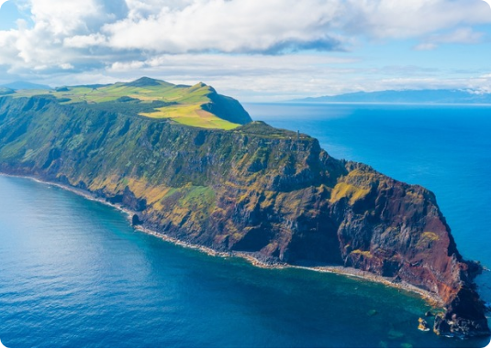
Destination: Ile Amsterdam
A Volcanic Pinprick in the Ocean
The Spotting: Around 4 PM, Sue and Jon ran to hug their father—they had spotted the island!
The Island: Ile Amsterdam, a small, stark French scientific base of volcanic rock.
Warm Welcome: Welcomed and anchored safely off-shore with the help of 28 native inhabitants.
Victory: Their endurance transformed a near-fatal shipwreck into a triumph of family spirit.
THE RESOLUTION
SLIDE 11

Slide 12

The Legacy
Core Themes & Essential Lessons from Chapter 2
Courage & Resilience
The Power of Optimism
Facing mortal danger with quiet discipline. Suzanne silently bore a heavy skull fracture to avoid worrying her parents in crisis.
Even in the direst stress, maintaining positive conviction guides successful rational choices, finding land against all odds.
"WORKING TOGETHER, WE CAN WEATHER ANY STORM."
EPILOGUE
SLIDE 12

Slide 13



Image Sources
https://as2.ftcdn.net/v2/jpg/03/47/61/47/1000_F_347614742_KekGszzjaBYlznqbFtJBHiEJJnAHQ8Qa.jpg
Source: www.posters.pl
https://www.68north.com/content/2020/04/friday-photo-380-storm-1030x686.jpg
Source: www.68north.com
https://www.explore.com/img/gallery/visit-this-remote-european-island-for-thrilling-outdoor-adventures/intro-1700258782.jpg
Source: www.explore.com

